Slide 1



Bird_strikes_data _visualisation
View in Power BI
Last data refresh:
8/24/2023 4:48:19 PM UTC
Downloaded at:
8/25/2023 4:00:34 PM UTC

Slide 2
BIRD STRIKES(2000- 2011)
Developed a Power BI dashboard to analyze the Bird Strike dataset from the year 2000 to 2011, aiming to predict and prevent fatal accidents caused by bird strikes.
Explored dataset parameters to understand their impact on accidents.

Slide 3
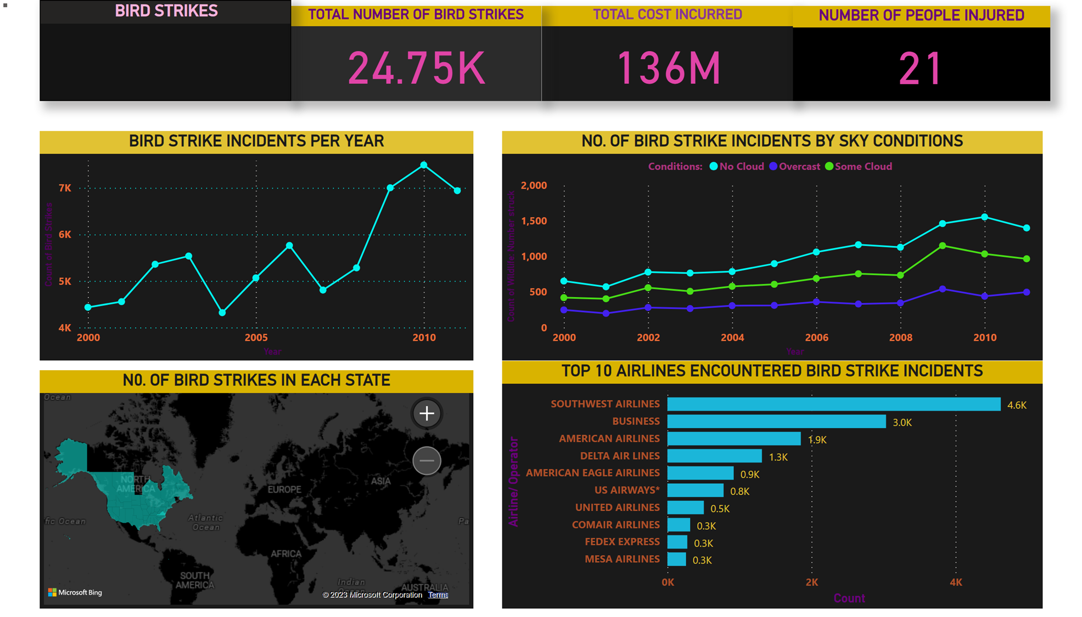

Slide 4
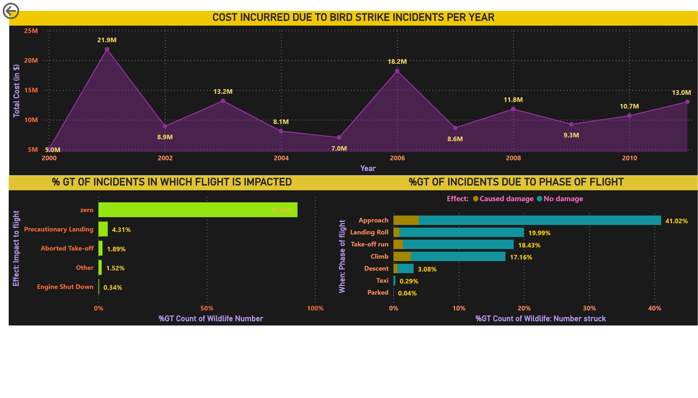

Slide 5
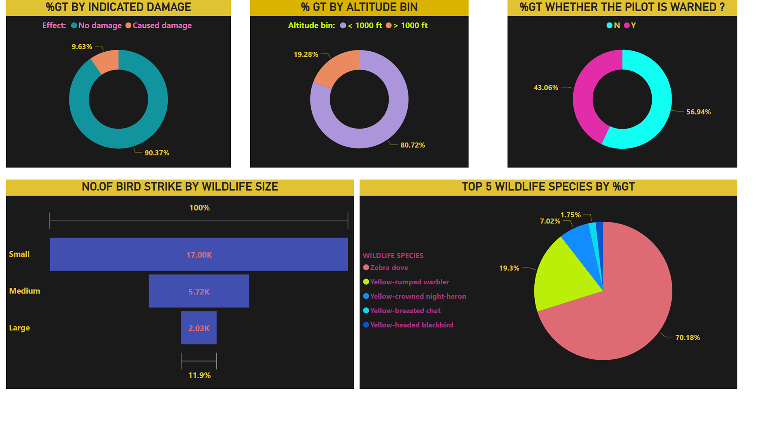

Slide 6
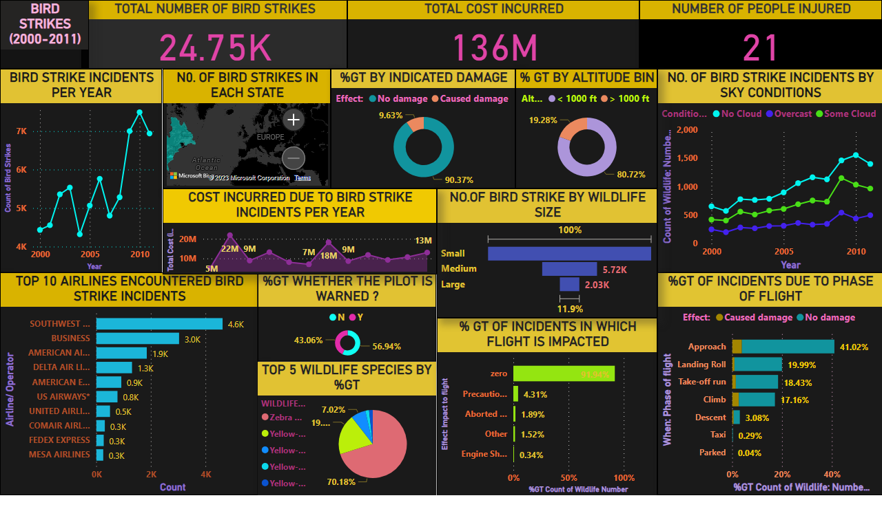
BIRD_STRIKES _DASHBOARD
Notes:
TOTAL NUMBER OF BIRD STRIKES
No alt text provided
BIRD STRIKES (2000-2011)
No alt text provided
TOTAL COST INCURRED
TOTAL COST INCURRED
NUMBER OF PEOPLE INJURED
No alt text provided
BIRD STRIKE INCIDENTS PER YEAR
No alt text provided
NO. OF BIRD STRIKE INCIDENTS BY SKY CONDITIONS
No alt text provided
N0. OF BIRD STRIKES IN EACH STATE
No alt text provided
TOP 10 AIRLINES ENCOUNTERED BIRD STRIKE INCIDENTS
No alt text provided
%GT BY INDICATED DAMAGE
No alt text provided
% GT BY ALTITUDE BIN
No alt text provided
%GT WHETHER THE PILOT IS WARNED ?
No alt text provided
TOP 5 WILDLIFE SPECIES BY %GT
No alt text provided
% GT OF INCIDENTS IN WHICH FLIGHT IS IMPACTED
No alt text provided
%GT OF INCIDENTS DUE TO PHASE OF FLIGHT
No alt text provided
NO.OF BIRD STRIKE BY WILDLIFE SIZE
No alt text provided
COST INCURRED DUE TO BIRD STRIKE INCIDENTS PER YEAR
No alt text provided

